Slide 1
Bayesian Optimization with Support Vector Regression
Jae Sang Ha
Seunghwan Nigel Kim

Slide 2
Agenda
Background
Problem Statement
Project Objective
Dataset Description
Implementation
Result
Conclusion
Notes:
First, I will briefly talk about the choice of hyperparameter tuning when optimizing an ML model.
Then, I will discuss about different hyperparameter optimization algorithms being used, and the importance of bayesian optimization
I will address project objective, then I will describe the two datasets that are used for this project.
From there, I will explain the implementation details and results.
Finally, I will end the presentation with the performance of Bayesian Optimization and its limitations.

Slide 3
Background
Model optimization
1. Modify code to minimize test error (within model)
2. Tune hyperparameters (outside model)
Hyperparameter?
settings that can be tuned, to control the behavior of a ML model
Notes:
Generally, in modern machine learning, we design the algorithm that minimizes the error and we change the behavior of that algorithm by changing different hyperparameters associated with that algorithm. For example, NN has a lot of hyperparameters that user has to specify such as # of nodes, # of layers. # of epochs, activation function, and as another example, Kernel selection always requires hyperparameter selection.

Slide 4
Hyperparameter Tuning
Manual Grid Search
Random Grid Search
Bayesian Optimization
Notes:
So, to tune the hyperparameter to generate the optimal behavior of the algorithm, we have methods to choose from. Commonly used tuning methods start from manual grid search, random grid search and advances to bayesian optimization. We will talk one by one in detail.

Slide 5
Manual Grid Search
Steps:
Build grid of all possible sets of hyperparameter
Evaluate for every combination
→ Takes a long time to sample
→ Curse of dimensionality
→ Random Grid Search partially solves it
Notes:
It is most common and easy to implement. Basic concept is that user input the “grid” of all possible sets of parameters and run the algorithm to find best parameter. Of course, it takes long time and, if the dimension is high, this method usually does not work. So we have another improved method to use, random grid search.
Curse of Dimentionality
“As the number of features or dimensions grows, the amount of data we need to generalize accurately grows exponentially”
Charles Isbell, Professor and Senior Associate Dean, School of Interactive Computing, Georgia Tech

Slide 6
Random Grid Search
Steps:
Build grid of all possible sets of hyperparameter
Randomly choose points and evaluate
→ Thankfully parallelizable.
→ No guarantee of reaching high-performance region
→ Basically, we are hoping to get lucky.
Notes:
The strength of random search lies in its simplicity. Given a learner M, with parameters x and a loss function f, random search tries to find x such that f is maximized, or minimized, by evaluating f for randomly sampled values of x.
This algorithm works well enough, if we can get samples from f cheaply. However, when you are training sophisticated models on large data sets, it can sometimes take on the order of hours, or maybe even days, to get a single sample from f.

Slide 7
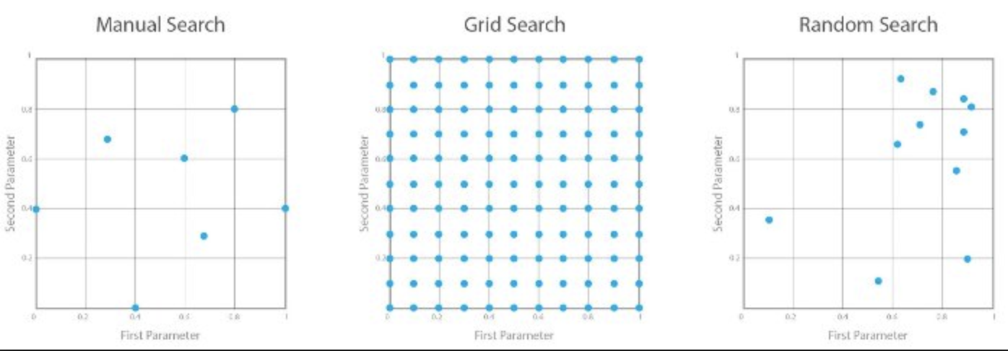
Visualizing Grid/Random Search
Notes:
In those cases, can we do any better than random search? It seems that we should be able to use past samples of f, to determine for which values of x we are going to sample f next.

Slide 8
Bayesian Optimization
What if we can steer the search to a region with better performance?
→ Previously evaluated hyperparameter values can guide us to optimal value.
Notes:
These algorithms use previous observations of the loss f, to determine the next (optimal) point to sample f for. The algorithm can roughly be outlined as follows.
Using previously evaluated points x1:n, compute a posterior expectation of what the loss f looks like. (updating your belief to select next optimal point)
Sample the loss f at a new point xnew, that maximizes some utility of the expectation of f. The utility specifies which regions of the domain of f are optimal to sample from. (choose theta for optimal utility value, then sample_loss f with using same theta)
These steps are repeated until some convergence criterion is met.

Slide 9
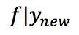
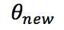
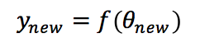
Algorithm (Bayesian Opt.)
repeat until (optimum):
do:
1. Update current belief of loss surface of the learner f.
2. Choose theta that maximizes some “utility” over the
current belief
3. Evaluate performance of learner f with
parameter theta.
Notes:
Given observed values f(x), update the posterior expectation of f using the GP model.
Find xnew that maximises the EI: xnew=argmaxEI(x).
Compute the value of ff for the point xnew
This procedure is either repeated for a pre-specified number of iterations, or until convergence.

Slide 10
Algorithm(Bayesian Opt.) - explained
1. Update current belief of loss surface of the learner f.
→ GP prior, Bayes rule to iteratively update posterior func
2. Choose theta that maximizes some “utility” over the
current belief
→ Utility function formalizes what the next best guess is
→ ex) Expected Improvement (EI) acquisition function
3. Evaluate performance of learner f with parameter theta.
4. Repeat from Step 1.
Notes:
To compute a posterior expectation, we need a likelihood model for the samples from f, and a prior probability model on f. For the prior distribution, we assume that the loss function f can be described by a Gaussian process (GP). We can think of a GP as a function that, instead of returning a scalar f(x), returns the mean and variance of a normal distribution over the possible values of ff at x.
A GP is a popular probability model, because it induces a posterior distribution over the loss function that is analytically tractable. This allows us to update our beliefs of what f looks like, after we have computed the loss for a new set of hyperparameters.
To find the best point to sample ff next from, we will choose the point that maximizes an acquisition function(utility). This is a function of the posterior distribution over f, that describes the utility for all values of the hyperparameters. The values with the highest utility, will be the values for which we compute the loss next.
EI: The nice thing about the expected improvement is, that we can actually compute this expectation under the GP model, by using integration by parts.
EI is high when the (posterior) expected value of the loss μ(x) is higher than the current best value f(x̂ ); or (Exploit)
EI is high when the uncertainty σ(x) around the point x is high. (Explore)
Intuitively, this makes sense. If we maximize the expected improvement, we will either sample from points for which we expect a higher value of f, or points in a region of f we haven’t explored yet (σ(x) is high). In other words, it trades off exploitation versus exploration.
Given observed values f(x), update the posterior expectation of f using the GP model.
Find xnew that maximises the EI: xnew=argmaxEI(x).
Compute the value of f for the point xnew.

Slide 11
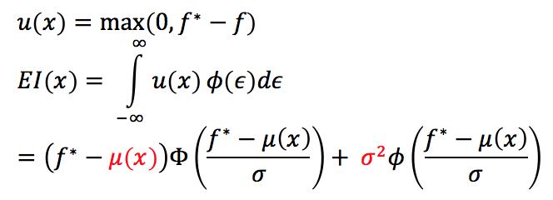
Utility - Expected Improvement(EI)
Similar to Probability of Improvement, but takes into account the size of improvement
EI can be maximized by:
decreasing the mean function or increasing the variance.
Notes:
EI: The nice thing about the expected improvement is, that we can actually compute this expectation under the GP model, by using integration by parts.
EI is high when the (posterior) expected value of the loss μ(x) is higher than the current best value f(x̂ ); or (Exploit)
EI is high when the uncertainty σ(x) around the point x is high. (Explore)
Intuitively, this makes sense. If we maximize the expected improvement, we will either sample from points for which we expect a higher value of f, or points in a region of f we haven’t explored yet (σ(x) is high). In other words, it trades off exploitation versus exploration.
Given observed values f(x), update the posterior expectation of f using the GP model.
Find xnew that maximises the EI: xnew=argmaxEI(x).
Compute the value of f for the point xnew.

Slide 12
Dataset Description
 | # of samples | # of features | Class labels | Distribution
Red-wine-quality¹ | 1599 | 11 | 0-10 (Integer) | Normal
Iris² | 150 | 4 | Iris Setosa Iris Versicolour Iris Virginica | Uniform
¹https://archive.ics.uci.edu/ml/datasets/wine+quality
²https://archive.ics.uci.edu/ml/datasets/iris
Notes:
fixed acidity, volatile acidity, citric acid, residual sugar, chlorides, free sulfur dioxide, total sulfur dioxide, density, pH, sulphates, alcohol
sepal length in cm, sepal width in cm, petal length in cm, petal width in cm

Slide 13
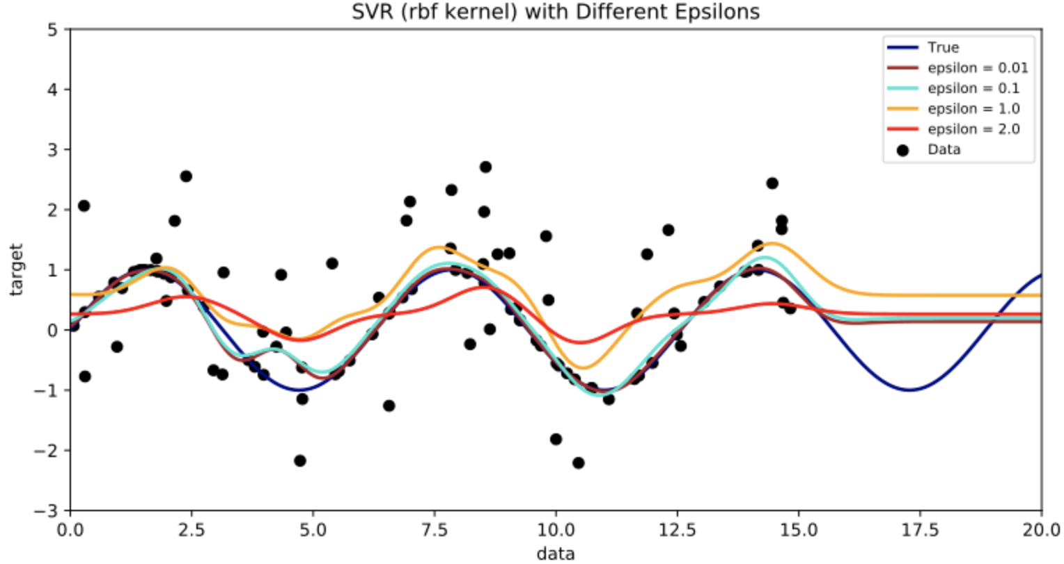
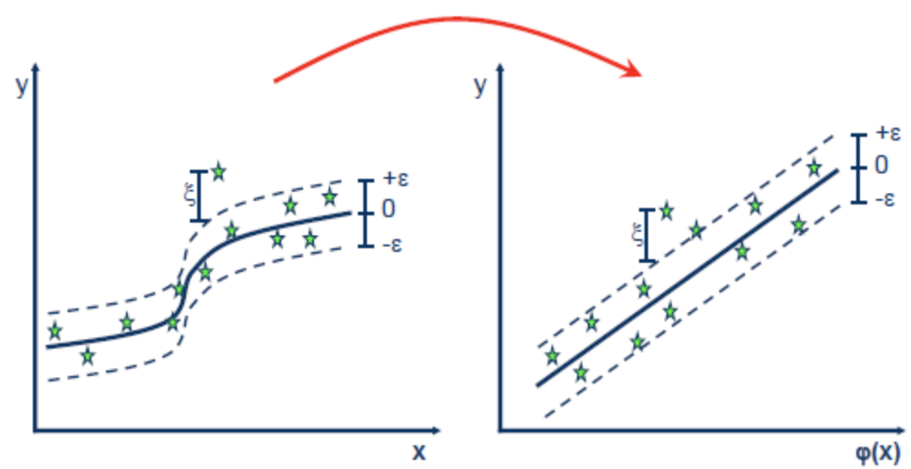
Support Vector Regression (SVR)
Notes:
SVR algorithm is sensitive to users' defined free parameters. The involved hyperparameters of SVR model consist of penalty parameter C, insensitive loss function parameter ε, and the parameter σ for kernel function. Inappropriate parameters in SVR can lead to overfitting or underfitting problems. How to properly set the hyperparameters is a major task, which has a significant impact on the optimal generalization performance and the SVR regression accuracy

Slide 14
Support Vector Regression (SVR)
rbf kernel
C
Penalty parameter C of the error term.
gamma
Kernel coefficient for ‘rbf’, ‘poly’ and ‘sigmoid’.
epsilon
Epsilon specifies the epsilon-tube within which no penalty is associated in the training loss function with points predicted within a distance epsilon from the actual value.
Notes:
The penalty parameter C controls the degree of punishing the samples whose errors go beyond the given value. The insensitive parameter ε controls the width of the ε-insensitive zone used to fit the training data. The value of ε can enhance the generalization capability; with the increase of ε, the number of support vectors will decrease, and the algorithmic computation complexity will also reduce. The bandwidth σ of the kernel function has a great influence on the performance of learning machine.

Slide 15
Implementation
Model: SVR (sklearn)
bound: ([-4,1], [-4,1], [-4,1])
loss function: Mean Squared Error (twice differentiable)
GP kernel: Matern(nu=2.5), RBF
Guessing vs. Bayesian Optimization
Guessing
C=2.0, gamma=2.0, epsilon=1.0
BO
# of iterations
10, 50, 200
GP kernel
Matern(nu=2.5, C=1, gamma=1)
RBF(C=1, gamma=1)
Notes:
For the underlying GP, we’ll assume a Matern kernel as the covariance function. in general the behaviour of the algorithm is dependent on the choice of the kernel. Using a Matern kernel, with the default parameters, means we implicitly assume the loss f is at least once differentiable. nu=2.5 (twice differentiable functions).

Slide 16
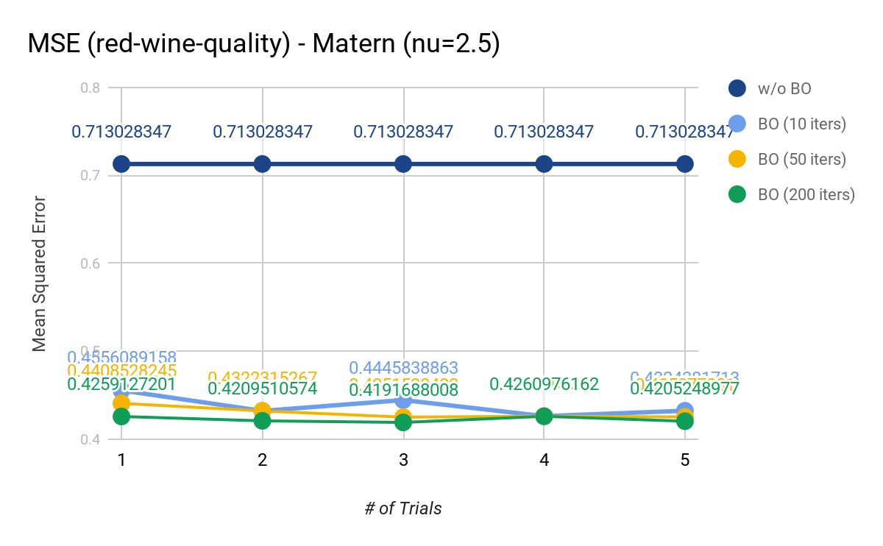
MSE(Different BO iterations)-Matern

Slide 17
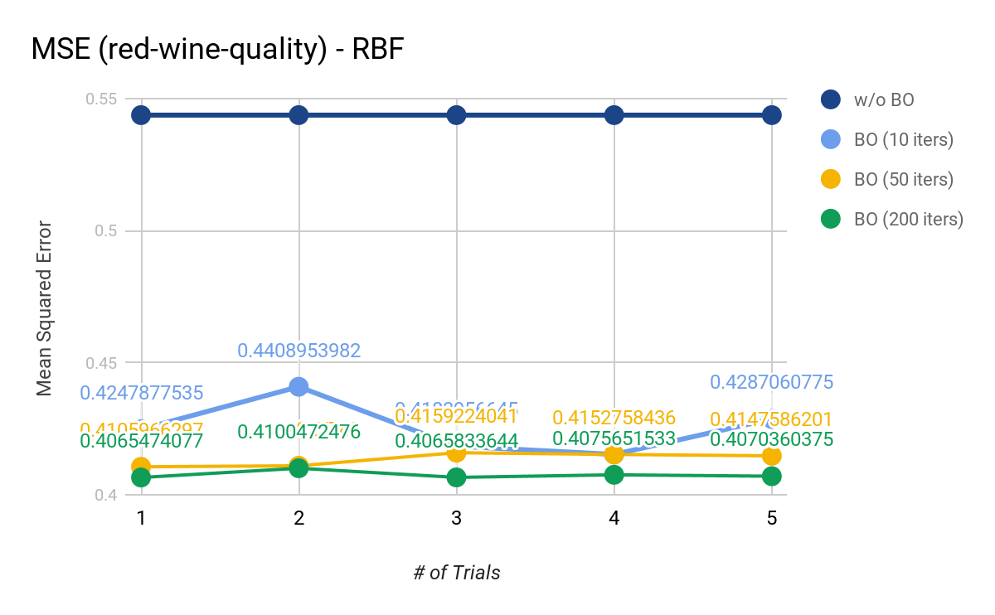
MSE(Different BO iterations)-RBF
Notes:
10 it:--- 11.4566268921 seconds ---
50 it:--- 70.2233669758 seconds ---
200 it:

Slide 18
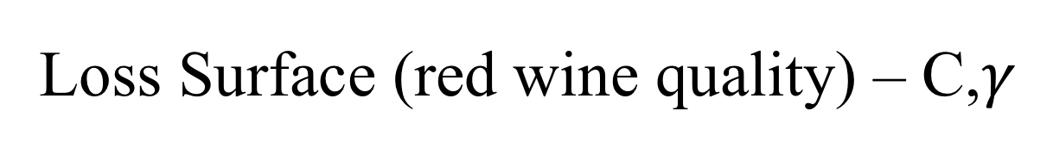
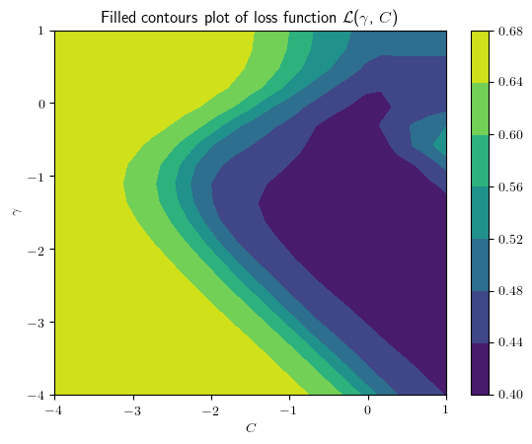
Notes:
we can actually compute the loss surface as a function of C and γ. This way, we can get an accurate estimate of where the true optimum of the loss surface is.

Slide 19
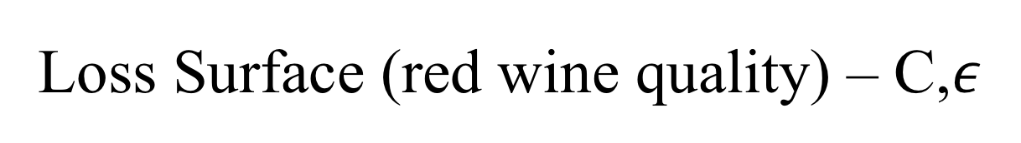
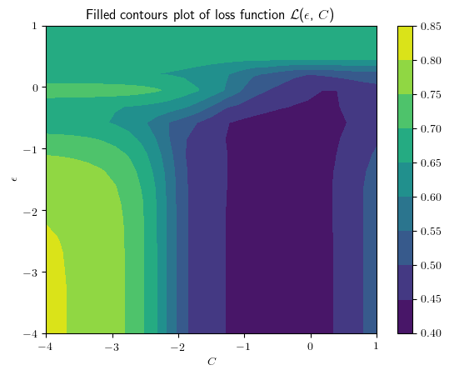

Slide 20
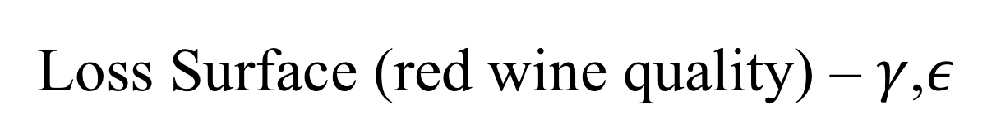
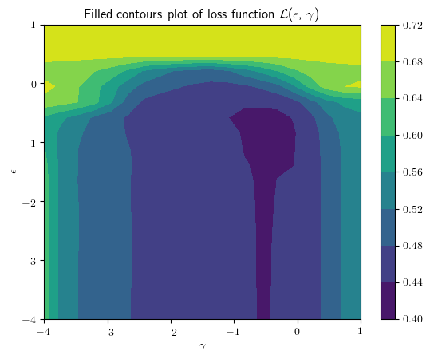

Slide 21
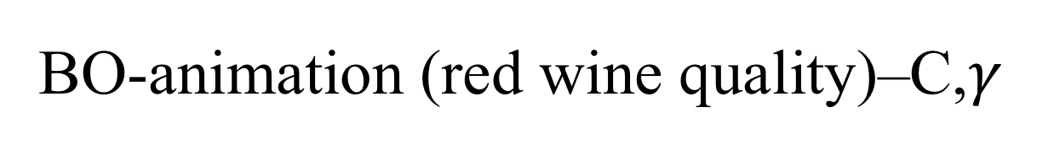
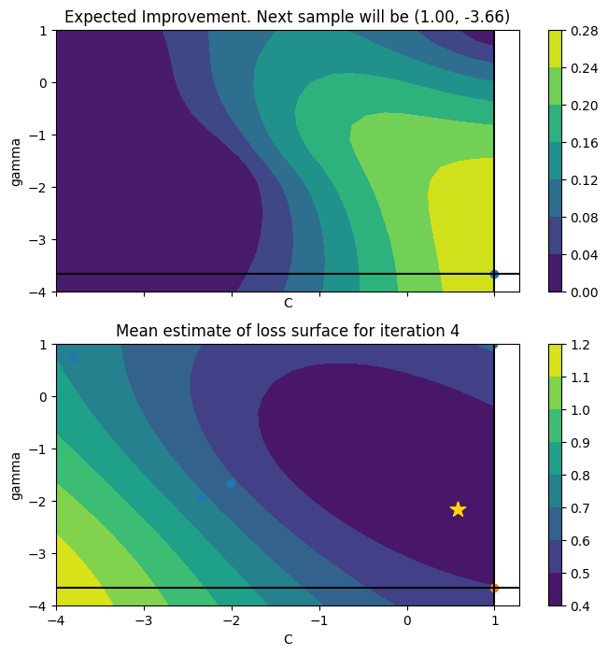
Notes:
The animation below shows the sequence of points selected, if we run the Bayesian optimization algorithm in this setting. We also warm-start the procedure with 5 random samples from f. The star shows the value of C and γ that result in the smallest value of MSE.
Initially, the algorithm explores the parameter space a bit, but it quickly discovers a region where we have good performance, and it samples points in that region.

Slide 22
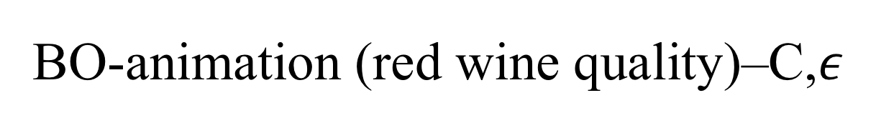
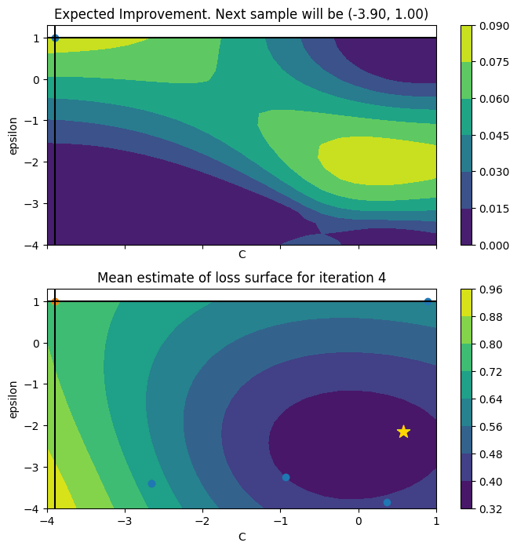

Slide 23
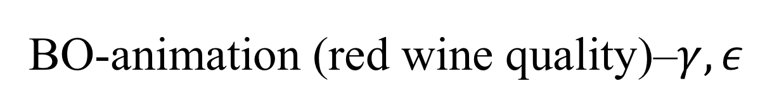
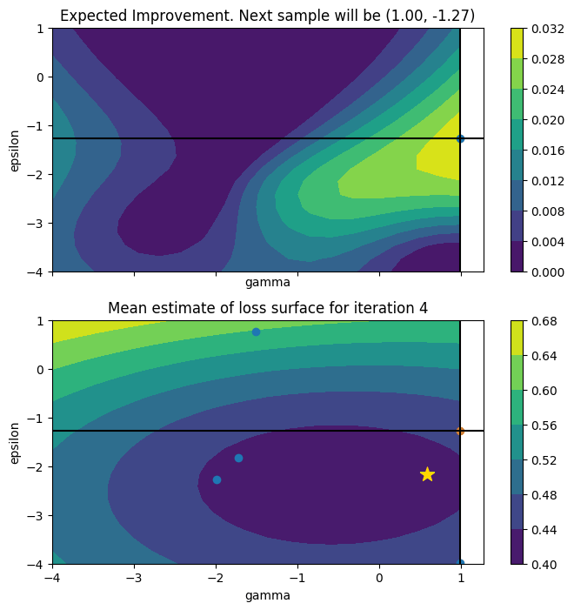

Slide 24
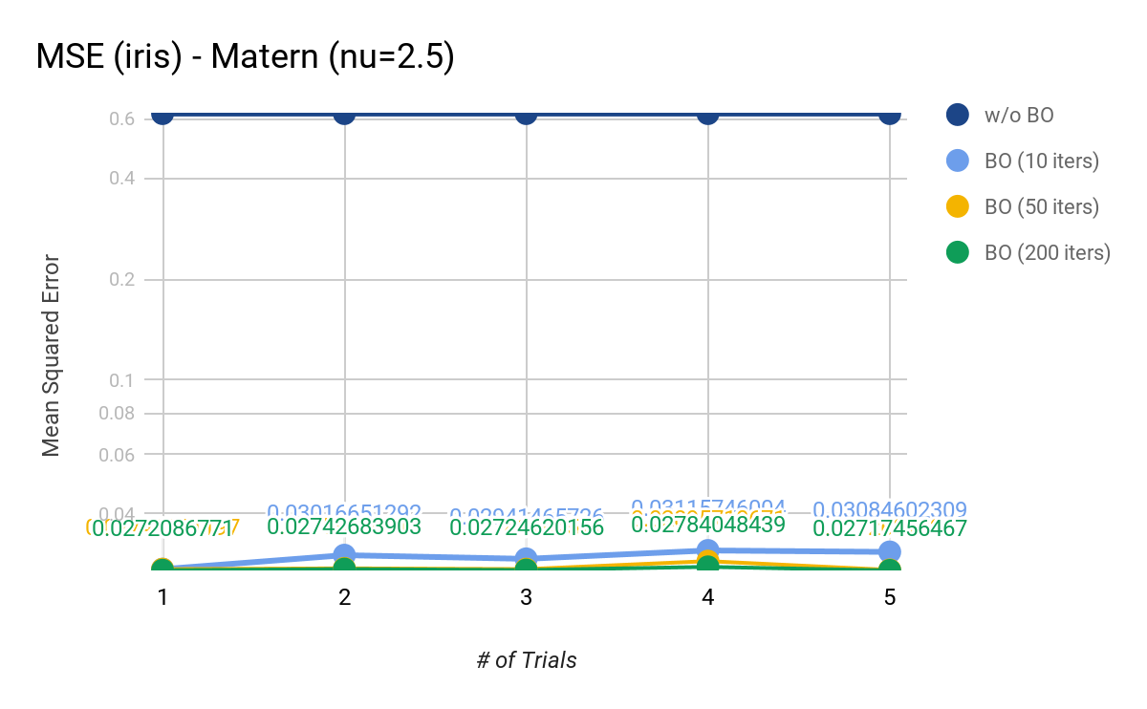
MSE(Different BO iterations)-RBF

Slide 25
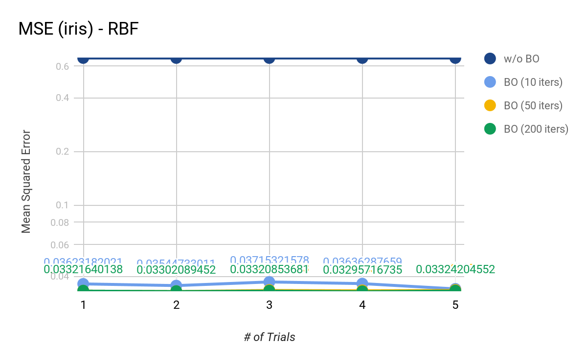
MSE(Different BO iterations)-RBF
Notes:
10 it:--- 11.4566268921 seconds ---
50 it:--- 70.2233669758 seconds ---
200 it:

Slide 26
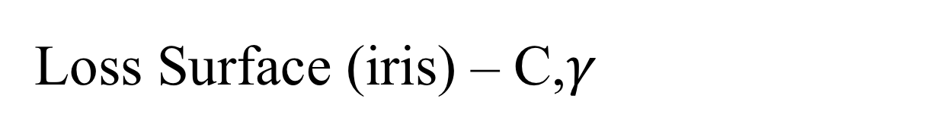
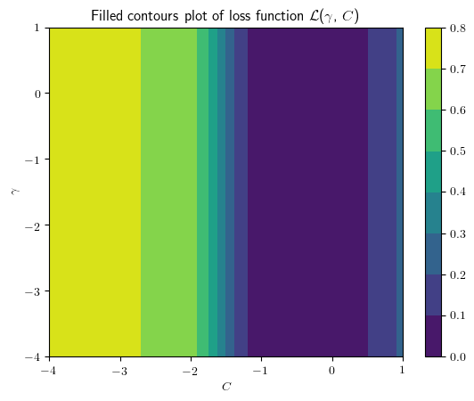

Slide 27
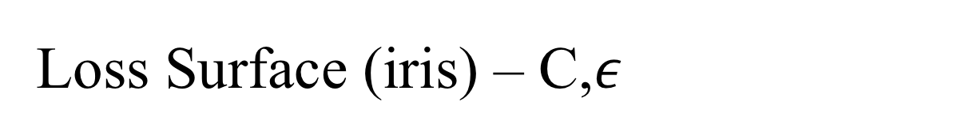
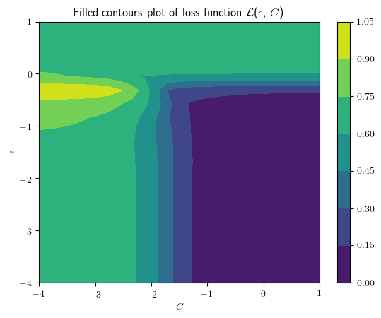

Slide 28
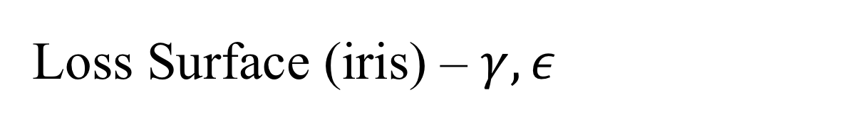
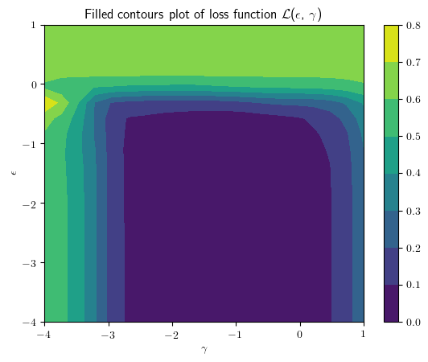

Slide 29
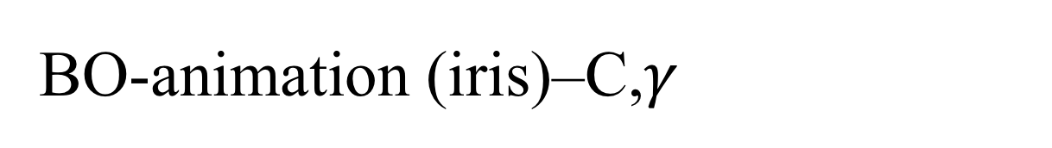
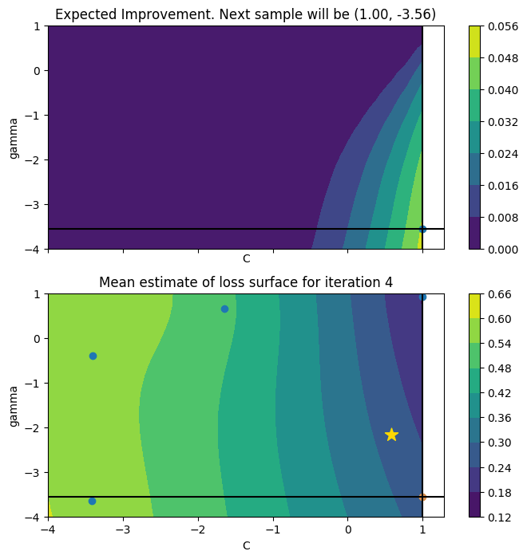

Slide 30
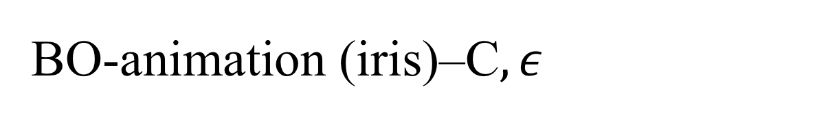
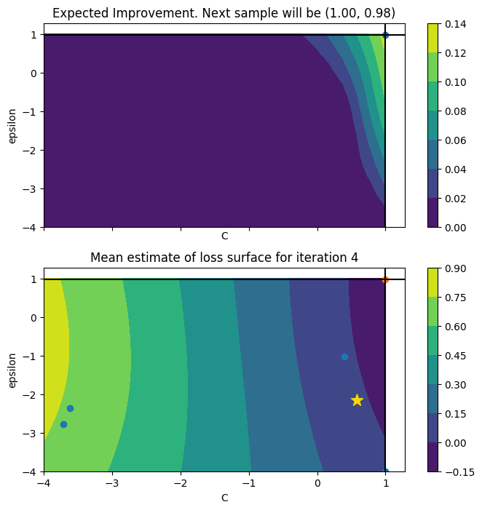

Slide 31
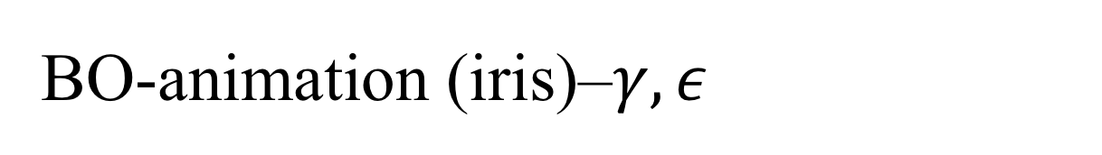
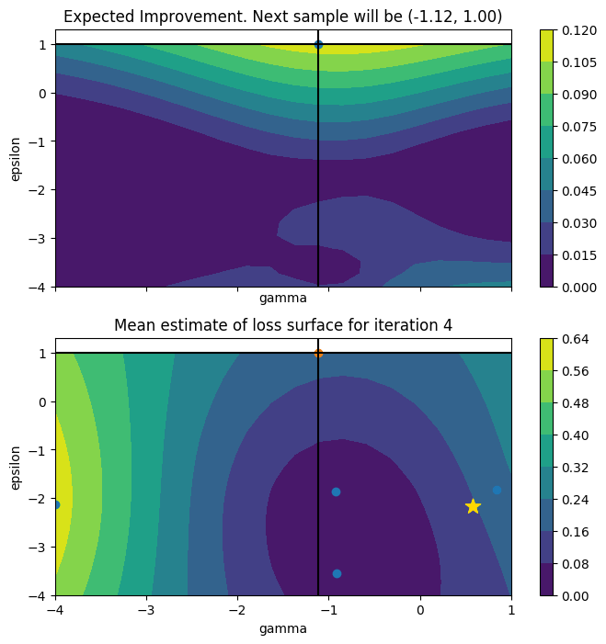

Slide 32
Limitations
GP kernel selection during belief update
Hyperparameter search domain bound setting
Bayesian Optimization builds a probabilistic performance metric model (computational overhead)
Becomes meaningful when:
# of hyperparameters is very large
Point evaluation of the performance function is expensive
Notes:
However, to tune your original machine learning model with this algorithm, it turns out you have to put considerable effort into tuning the search algorithm itself! I have found that the following are some practical things to consider:
Choose an appropriate scale for your hyperparameters: For parameters like a learning rate, or regularization term, it makes more sense to sample on the log-uniform domain, instead of the uniform domain.
Kernel of the GP: Different kernels have a drastic effect on the performance of the search algorithm. Each kernel implicitly assumes different properties on the loss f, in terms of differentiability and periodicity.

Slide 33
Conclusion
State-of-the-art Hyperparameter Optimization
Bayesian Optimization
Datasets
Implementations
Limitations
Notes:
If an exact functional form for f is not available (that is, f behaves as a “black box”), what can we do? Bayesian optimization proceeds by maintaining a probabilistic belief about f and designing a socalled acquisition function to determine where to evaluate the function next. Bayesian optimization is particularly well-suited to global optimization problems where f is an expensive black-box function; for example, evaluating f might require running an expensive simulation. Bayesian optimization has recently become popular for training expensive machine-learning models whose behavior depend in a complicated way on their parameters (e.g., convolutional neural networks).

Slide 34
References
Huijskens, Thomas, “Bayesian Optimization with Scikit-learn”. https://thuijskens.github.io/2016/12/29/bayesian-optimisation/
Jiang, Mingfeng, et al. "Study on parameter optimization for support vector regression in solving the inverse ECG problem." Computational and mathematical methods in medicine 2013 (2013).
Snoek, Jasper, Hugo Larochelle, and Ryan P. Adams. "Practical bayesian optimization of machine learning algorithms." Advances in neural information processing systems. 2012.

